Slide 1
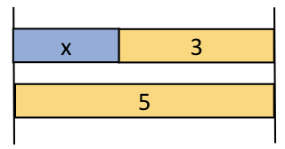
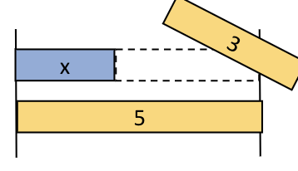
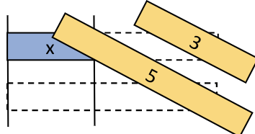
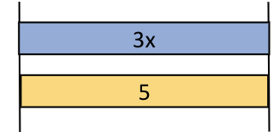
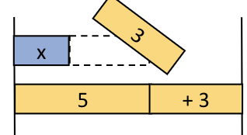
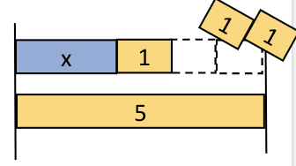
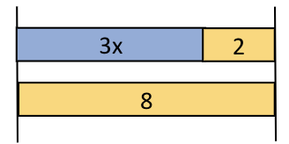
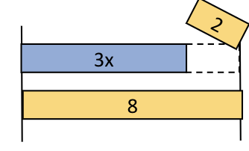
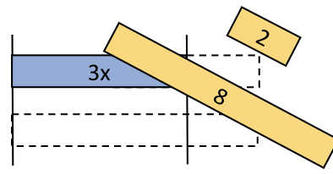
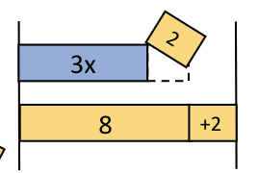
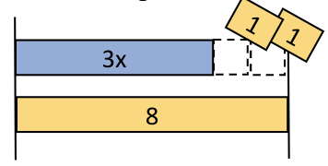
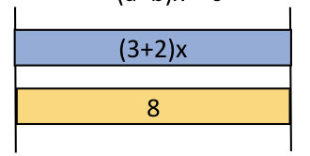
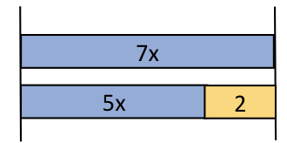
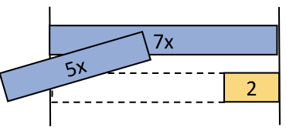
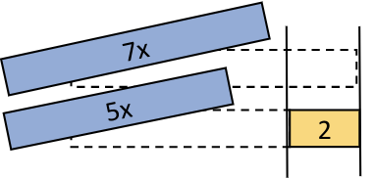
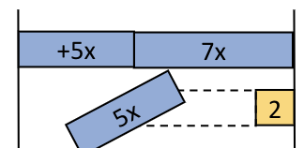
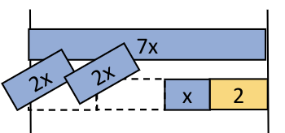
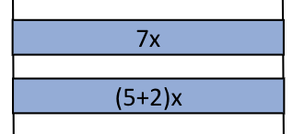
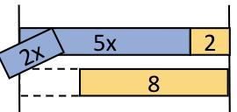
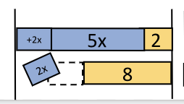
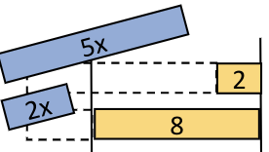
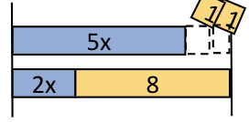
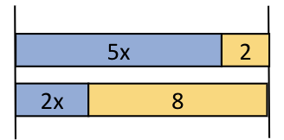
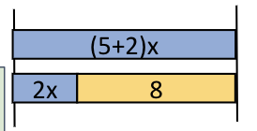
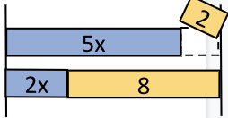
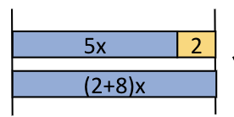
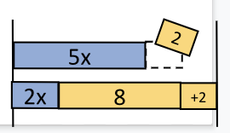
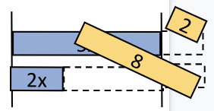
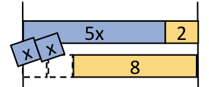
Incorrect diagram options for subtraction
Original equation | 1. Subtracting only from one side (smaller constant term) | 2. Subtracting different numbers from both sides | 3. Combining unlike terms | 5. Subtracting from one side, adding to the other side | 8. Subtracting twice from one side
x + a = b | x + a - a = b | x + a - a = b - b | ax = b | x + a - a = b + a | x + a - c - c = b *a>1
ax + b = c | ax + b - b = c | ax + b - b = c - c | (a+b)x = c | ax + b - b = c + b | ax + b - d - d = c *b>1
ax = bx + c | ax = bx - bx + c | ax - ax = bx - bx + c | ax = (b + c)x *when b = 1, ax = cx | ax + bx = bx - bx + c | ax = bx - d -d + c *b>1
ax + b = cx + d *a>c, d>b | ax + b - b = cx + d, or ax + b = cx - cx + d | ax + b - b = cx + d - d, or ax - ax + b = cx - cx + d | (a + b)x = cx + d *when a = 1, bx = cx + d, , or ax + b = (c + d)x *when c = 1, ax + b = dx | ax + b - b = cx + d + b, or ax + cx + b = cx - cx + d | ax + b - e - e = cx + d , or ax + b = cx - ex - ex + d *b>1, c>1, respectively

Slide 2
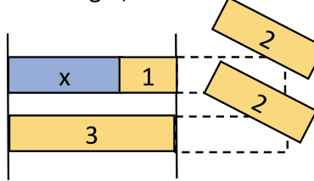
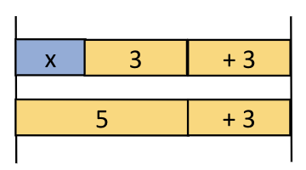
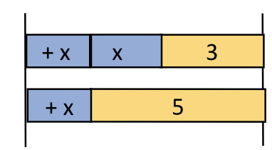
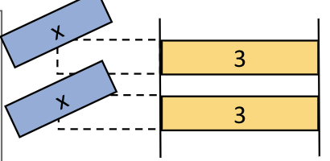
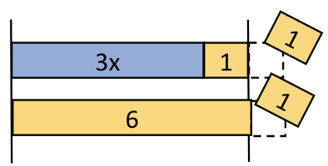
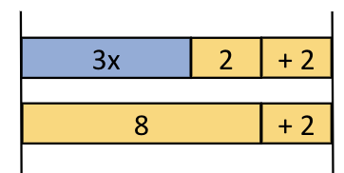
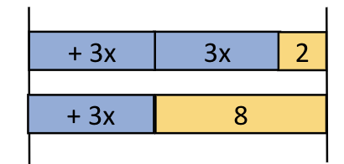
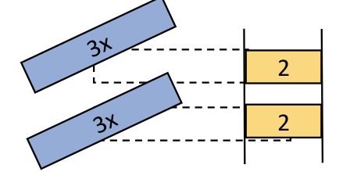
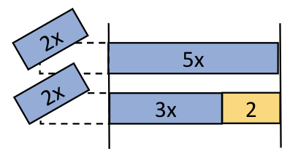
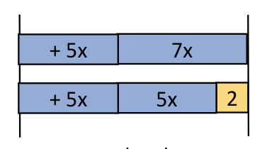
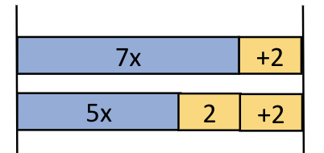
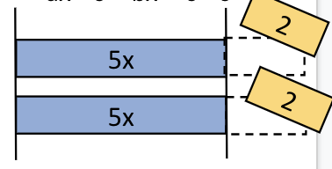
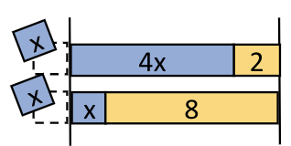
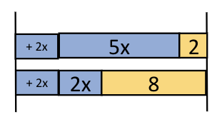
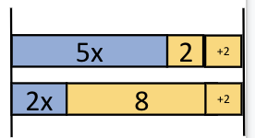
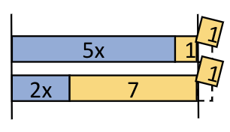
Correct-but-non-strategic diagram options for subtraction
Original equation | 4. Subtracting the same thing from both sides but subtracting only a part of what needs to be subtracted | 6. Adding the same thing to both sides | 7. Subtracting an inappropriate term from both sides
x + a = b | x + a - c = b - c *c: integer, 0<c<a | x + a + a = b + a x + a + x = b + x | x + a - x = b - x
ax + b = c | ax + b - d = c - d *d: integer, 0<d<b, b>1 | ax + b + b = c + b ax + b + ax = c + ax | ax + b - ax = c - ax
ax = bx + c | ax - dx = bx - dx + c *d: integer, 0<d<b, b>1 | ax + bx = bx + bx + c ax + c = bx + c + c | ax - c = bx + c - c
ax + b = cx + d *a>c, d>b | ax + b - ex = cx + d - ex *e: integer, 0<e<c, c>1 ax + b - e = cx + d - e *e: integer, 0<e<b, b>1 | ax + b + cx = cx + cx + d ax + b + b = cx + d + b

Slide 3
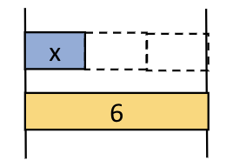
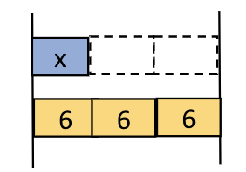
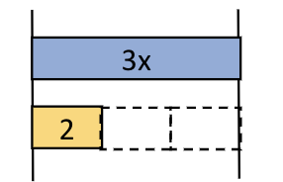
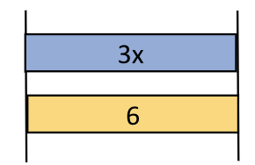
Incorrect diagram options for division
Original equation | 1. Divide only one side (variable) | 3. Divide one side (variable), multiply the other side (constant) | 4. Divide only one side (constant)
ax = b | ax/a = b | ax/a = b*a | ax = b/a

Slide 4
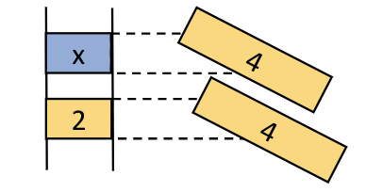

Correct-but-non-strategic diagram options for division
Original equation | 2. Subtraction instead of division | 4. Multiply both sides
ax = b | ax - c = b - c *c: b - b/a | ax*a = b*a

